Slide 1
Software Design & Architecture
Lecture # 06
System Sequence Diagrams

Slide 2
Outline
Why System Sequence Diagrams
What are System Sequence Diagrams
Example from Process Sale Use Case
Guidelines

Slide 3
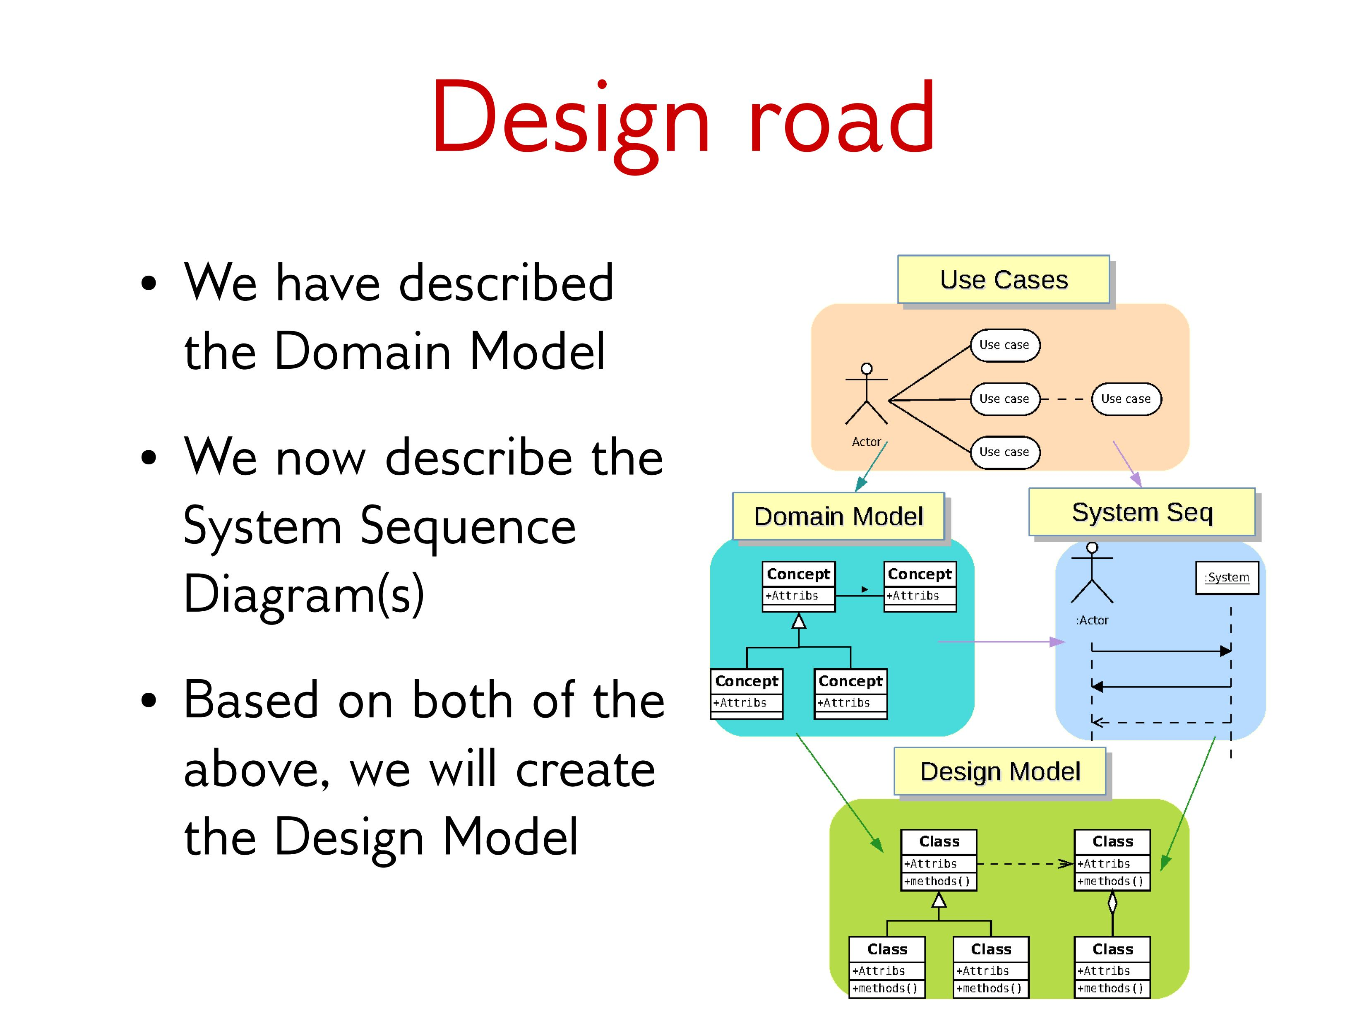
Design Road

Slide 4
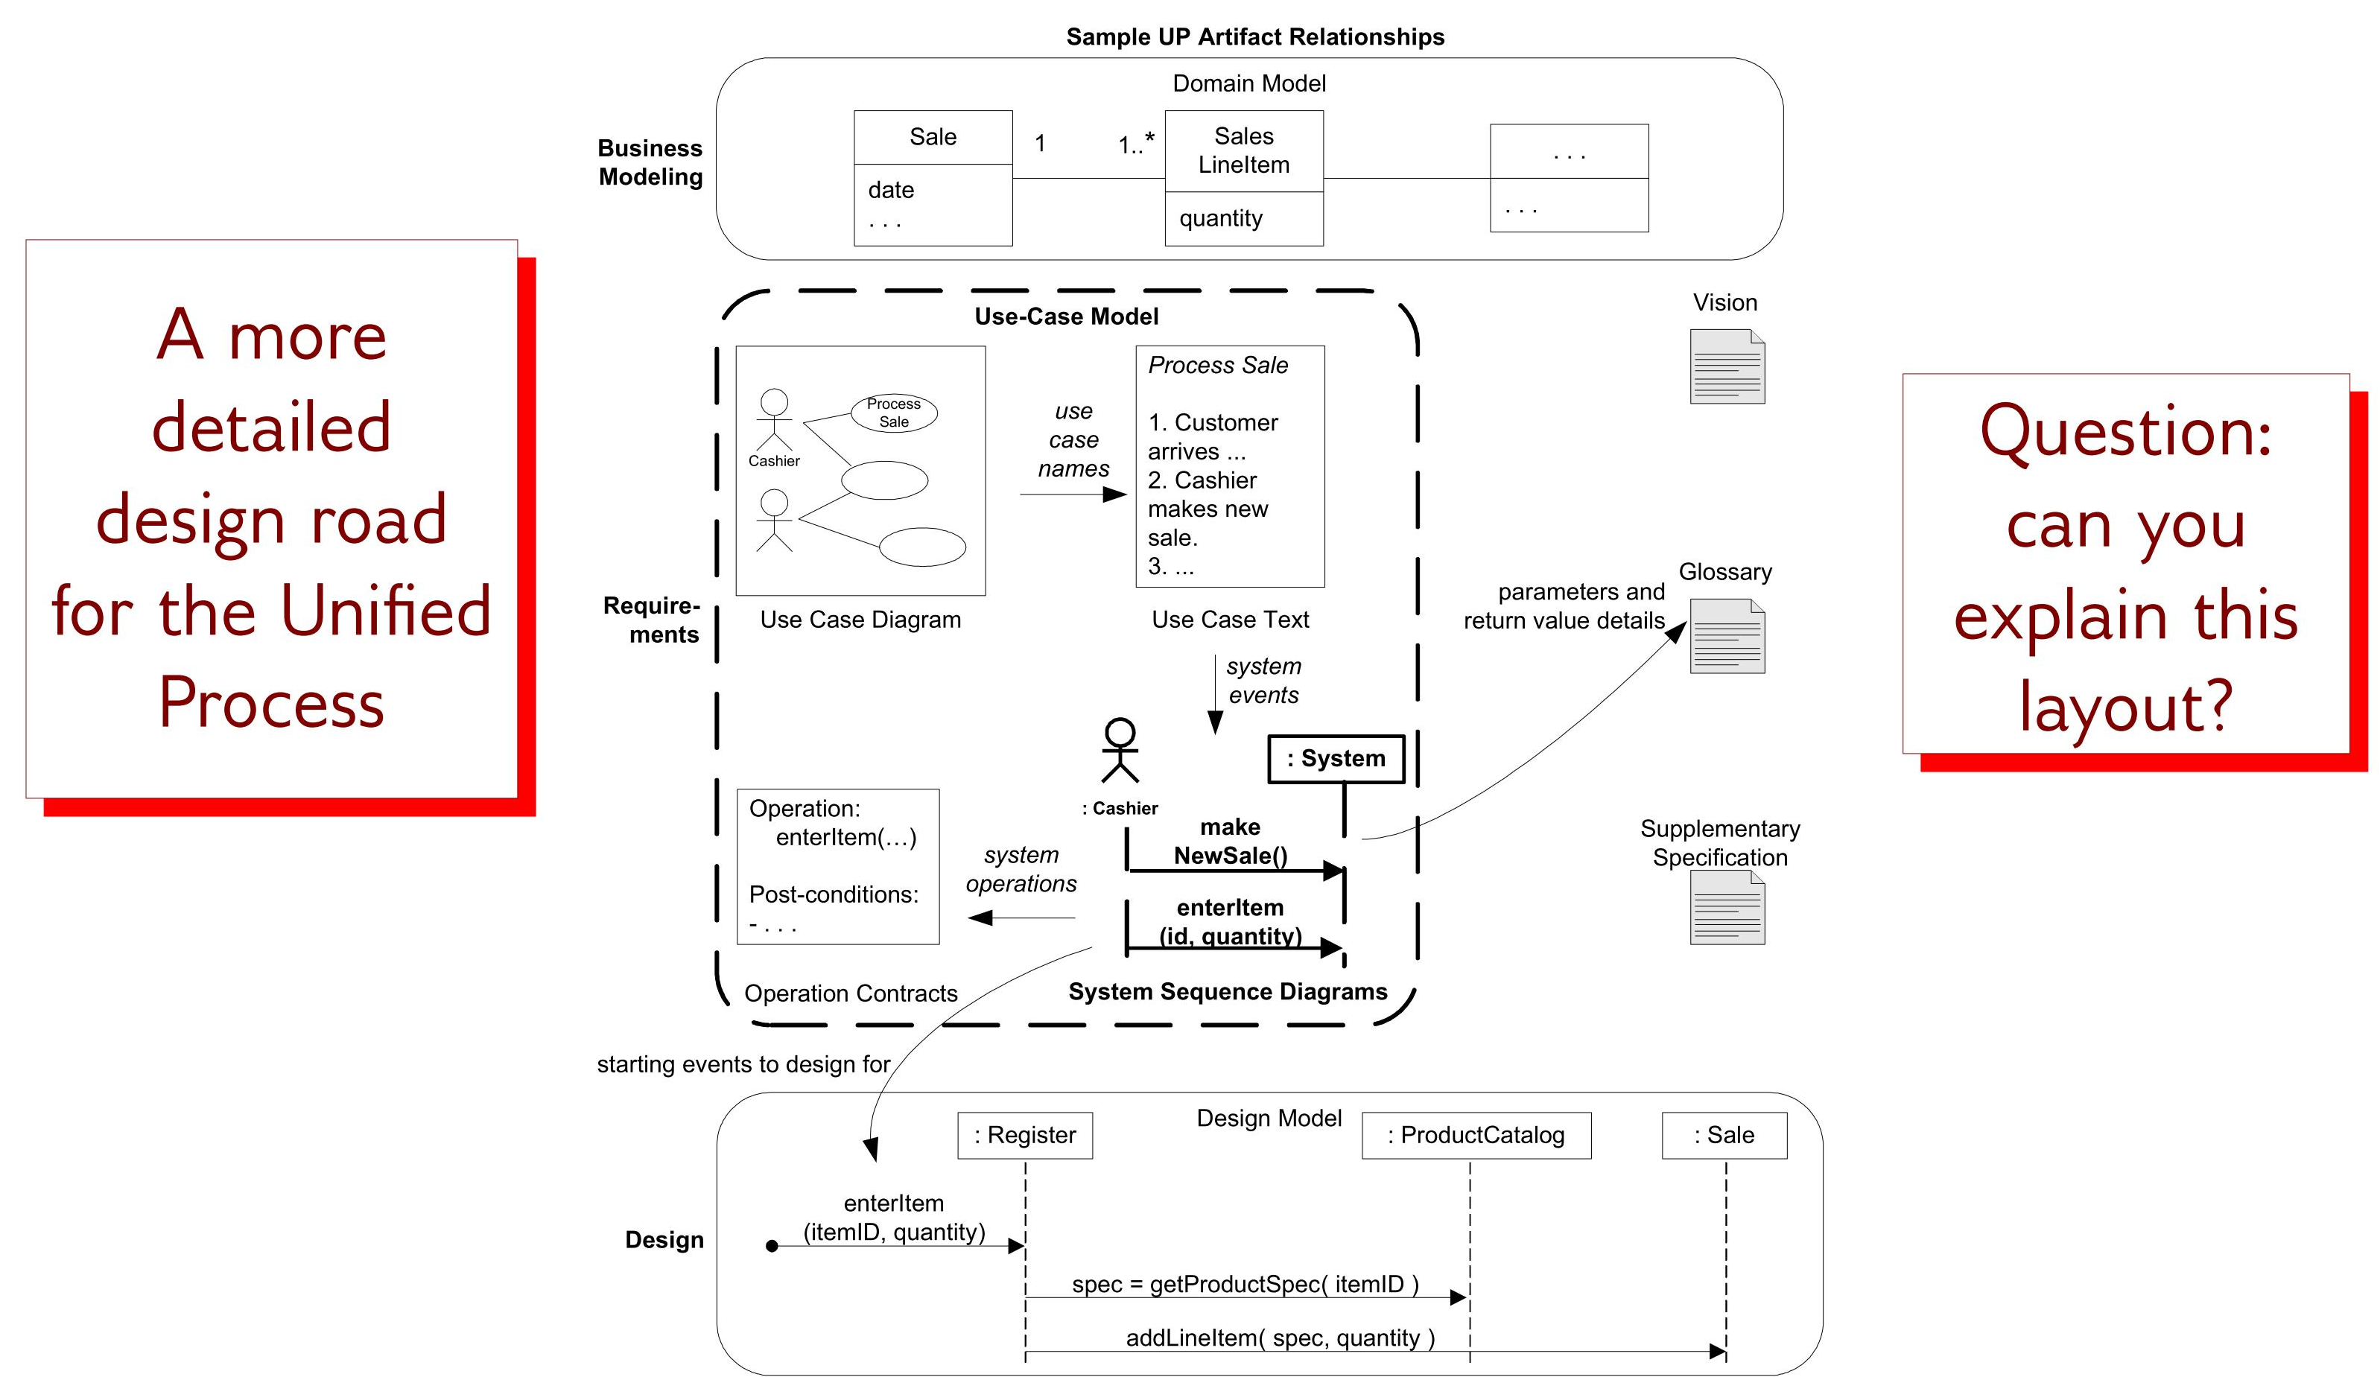
Design Road

Slide 5
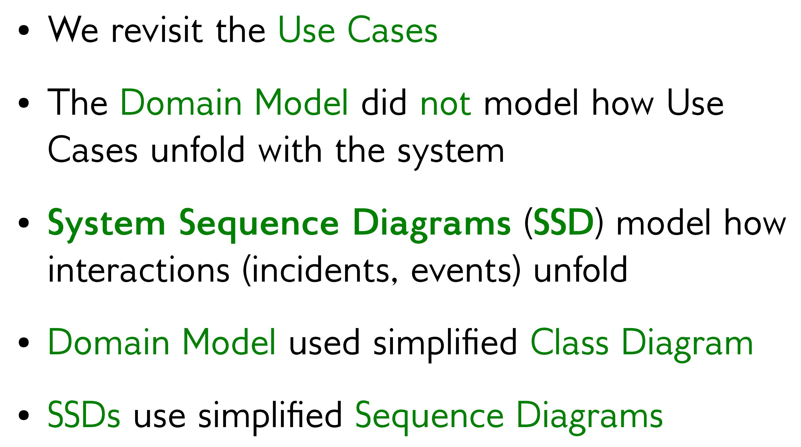
SSDs

Slide 6
SSDs
The OOAD challenge
UCs are functional but System is OO
This is a modeling paradigm mismatch
How to make the functional-OO transition
Without losing any requirements
Being able to demonstrate no requirements are lost
End up with a correct, robust & flexible OO system
Ultimately, every requirement must be an assigned responsibility for some object

Slide 7
SSDs
A system sequence diagram is a picture that shows, for one particular scenario of a use case, the events that external actors generate, their order, and inter-system events.
All systems are treated as a black box; the emphasis of the diagram is events that cross the system boundary from actors to systems.
System Events or System Operation
it is useful to investigate and define system’s behavior as a "black box."
System behavior is a description of what a system does, without explaining how it does it.
The UML does not define something called a "system" sequence diagram but simply a "sequence diagram."

Slide 8
SSDs
SSDs are one of the books’ best ideas
SSD is the key model that
Links UCs with OO models (e.g., class & sequence)
Supported by operation contracts (next chapter)
Establishes traceability of requirements into OO models

Slide 9
SSDs
A UC specifies functionality
A UC scenario is a time-ordered series of function calls that Actor invokes on System
Larman calls them system operations or system events
Key tasks are
Identify the functions in a UC scenario
Translate them into UML function syntax
Draw a sequence diagram (easy part)
Easier if you have simple, complete UCs

Slide 10
SSDs
Can draw object model containing two objects
Actor & System
System operations are functions gleaned from UCs
Maps UC functionality onto OO models for further refinement

Slide 11
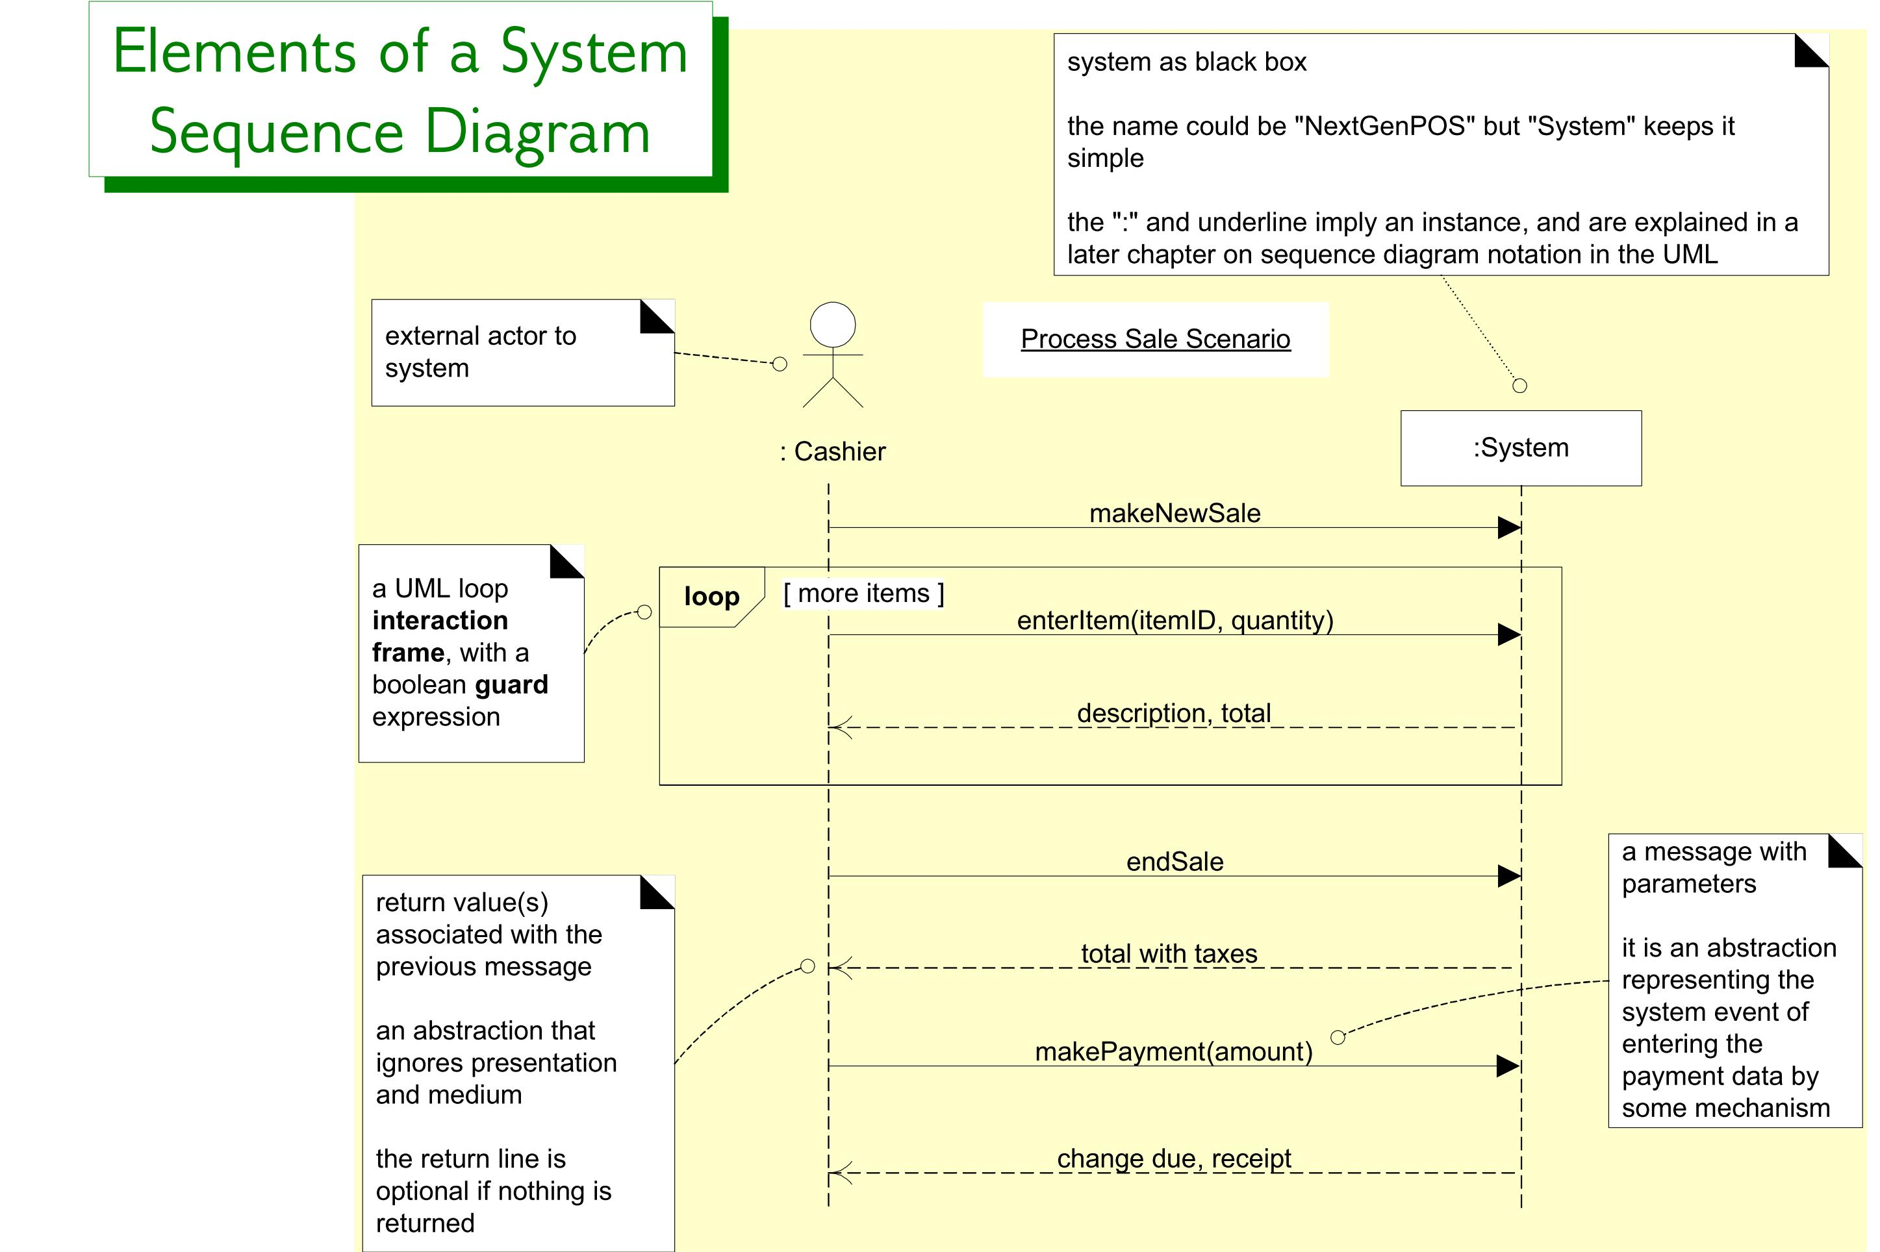
SSD for a Process Sale scenario
SSDs

Slide 12
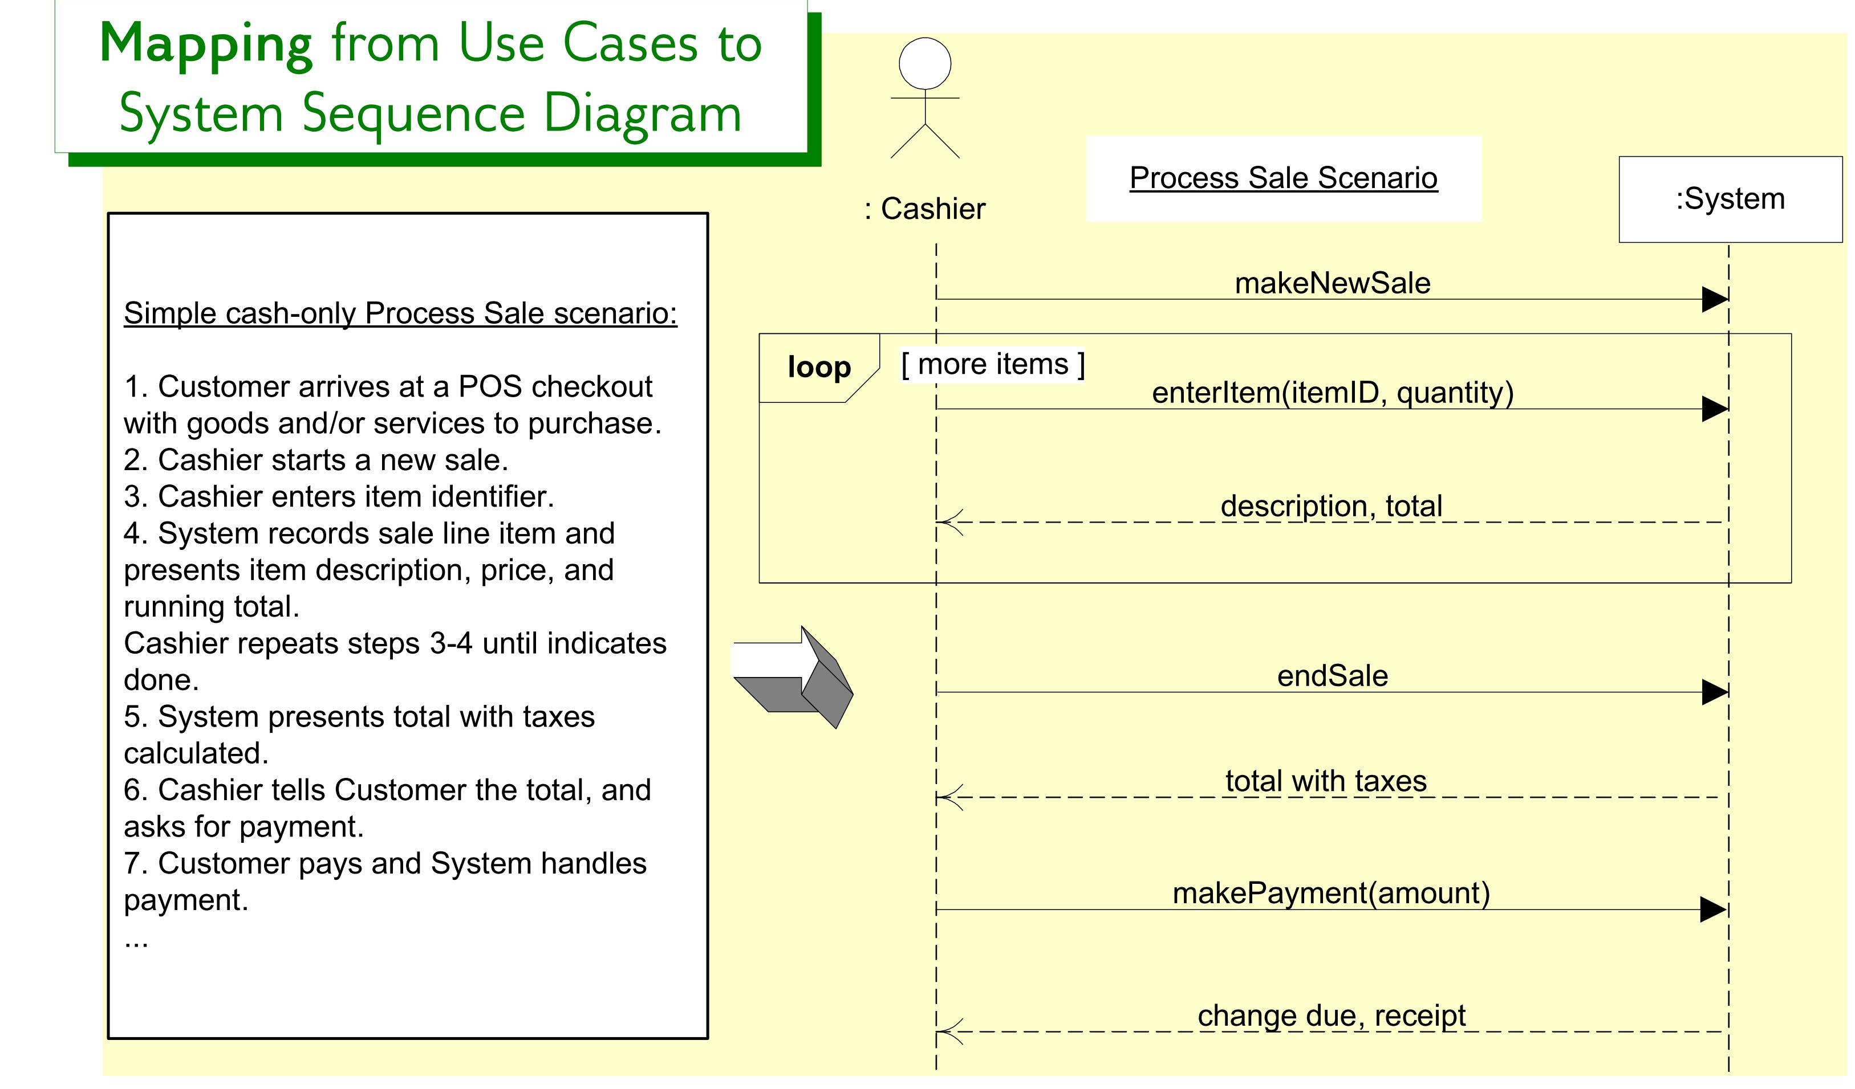
SSDs are derived from use cases; they show one scenario.

Slide 13
Process Sale UC
UC: Process Sale
→ makeNewSale()
User selects new sale option (Request--invocation)
System requests item identifier (Response--return)
→ enterItem(itemID, quantity)
User enters item identifier & quantity
System records sale of item, and
System displays item description, price, current total
Steps 2-5 repeated until user finished
→ endSale()
6. User selects sale finished option
System displays total and taxes due
→ makePayment(amount)
User enters payment information
System handles payment
→ recordSale() (Why not show this on SSD?)
System logs completed sale and sends sale information to Accounting System and Inventory System
System generates receipt

Slide 14
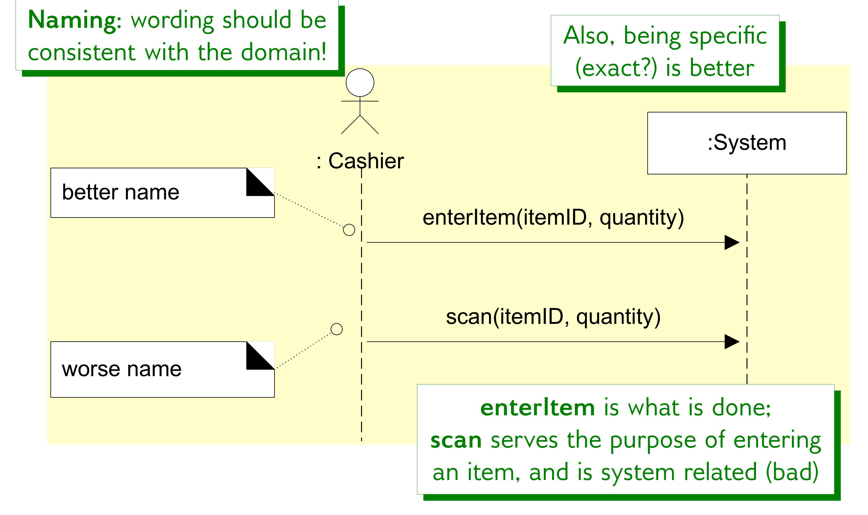
SSDs

Slide 15
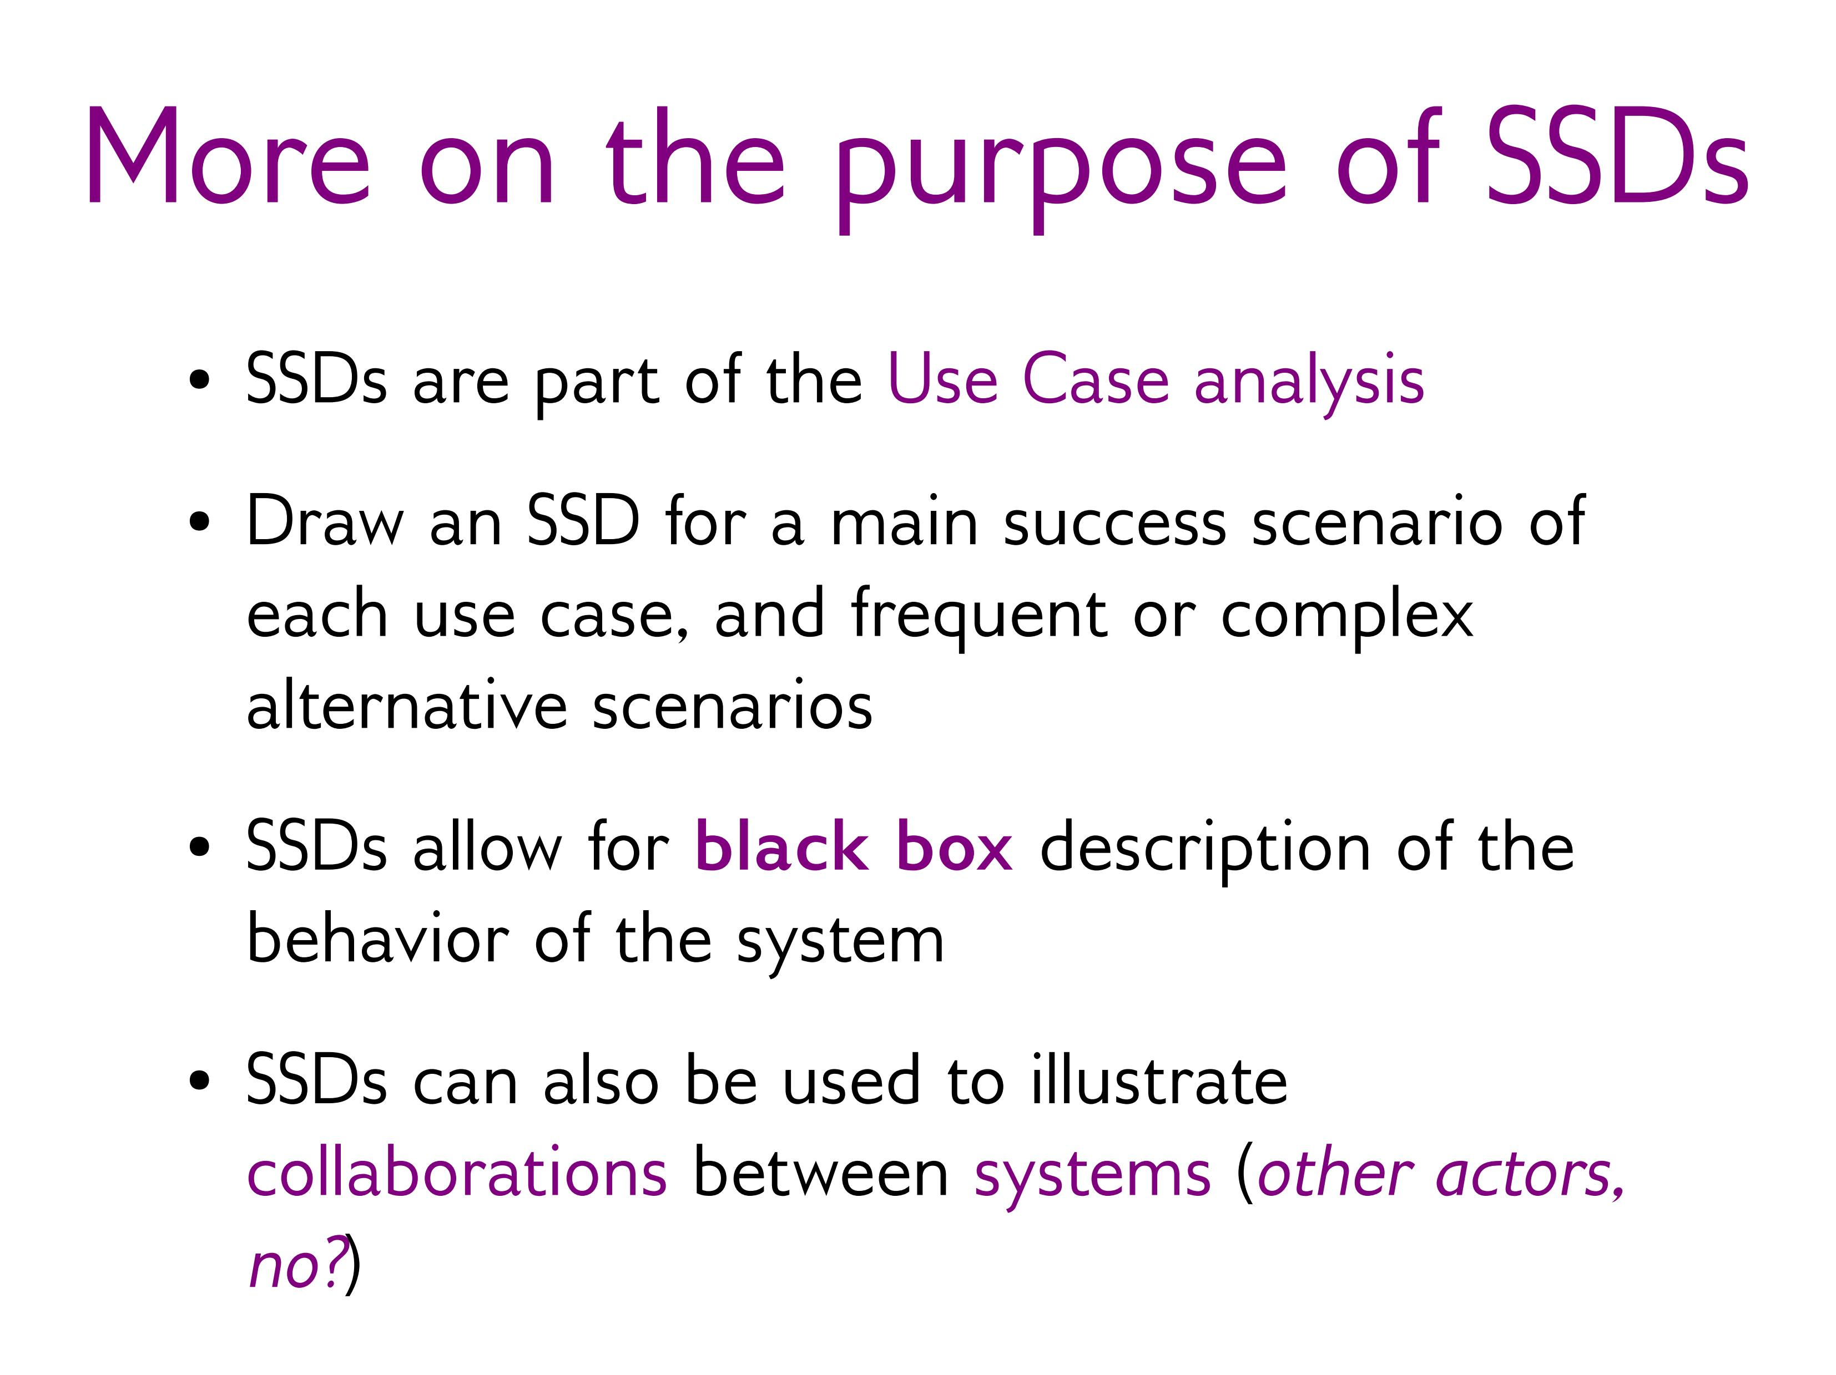
More on purpose of SSDs

Slide 16
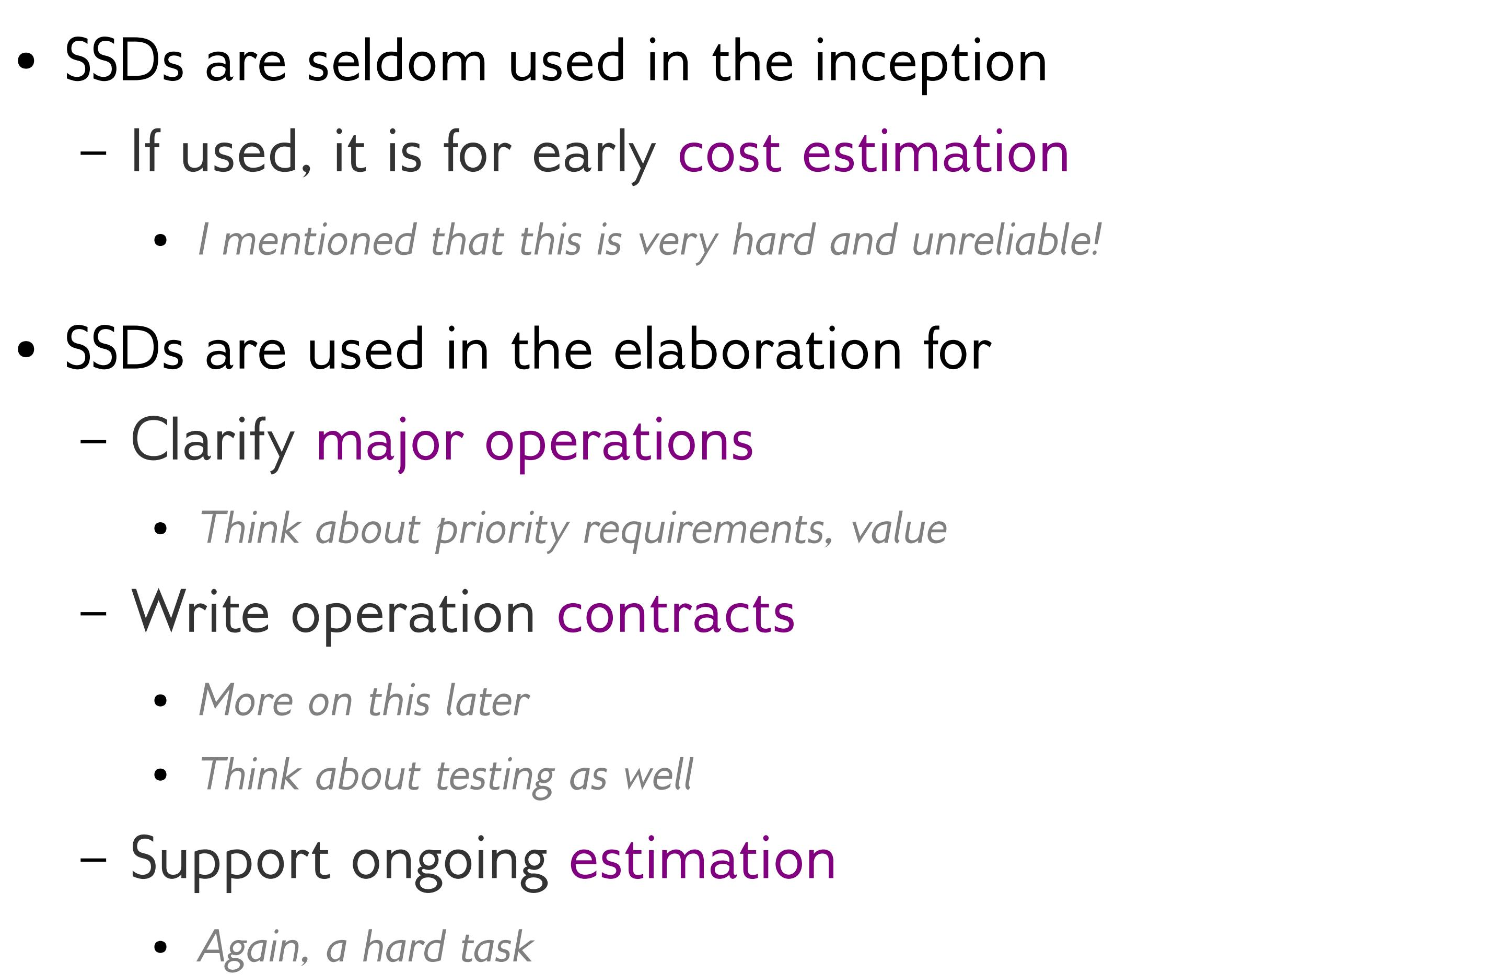
More on purpose of SSDs

Slide 17
Recommended Reading
Chapter # 10: System Sequence Diagrams from Applying UML and Patterns: An Introduction to Object-Oriented Analysis and Design and Iterative Development by Craig Larman, 3rd Edition

